Slide 1

Lab 5-6: Exploring the Parallel MATLAB (MandelBrot Set)
Indian Institute of Technology Gandhinagar
ES-611: Algorithms on Advanced Computer Architecture
Group-4
Nishant N. Rao 11110059 | Ravi Kumar 11110081
Parth Gudhka 11110062 | Shashank Heda 11110094

Slide 2
Important Points
Maximum iteration
Grid Size
GPU Array Function

Slide 8
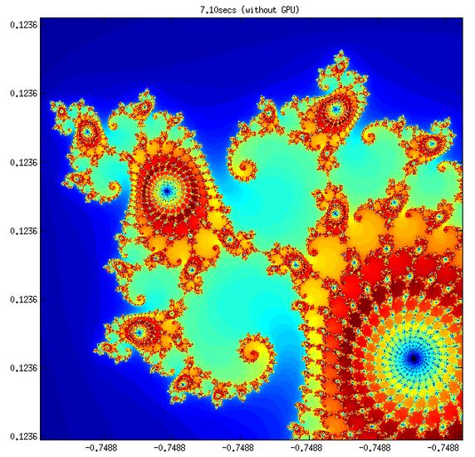

Slide 9
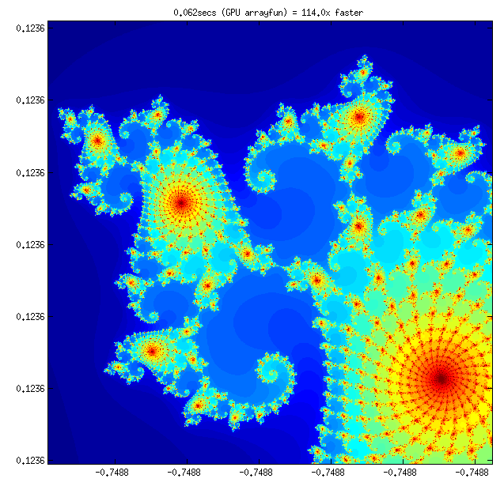

Slide 10
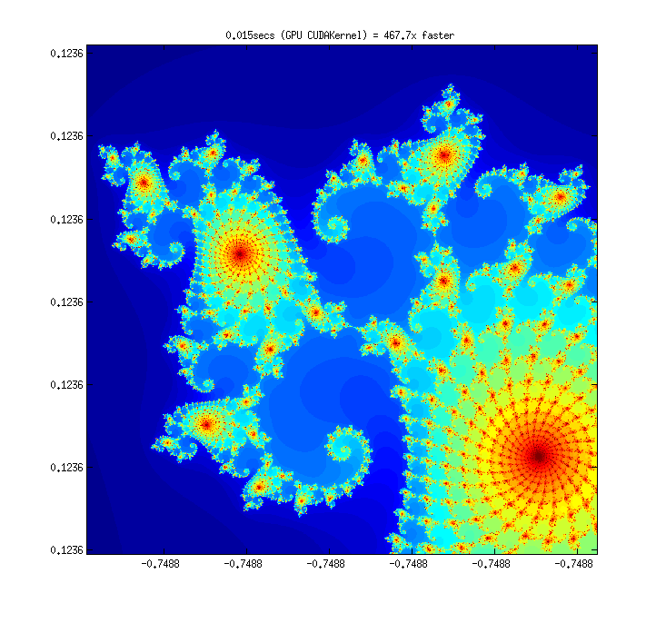

Slide 13
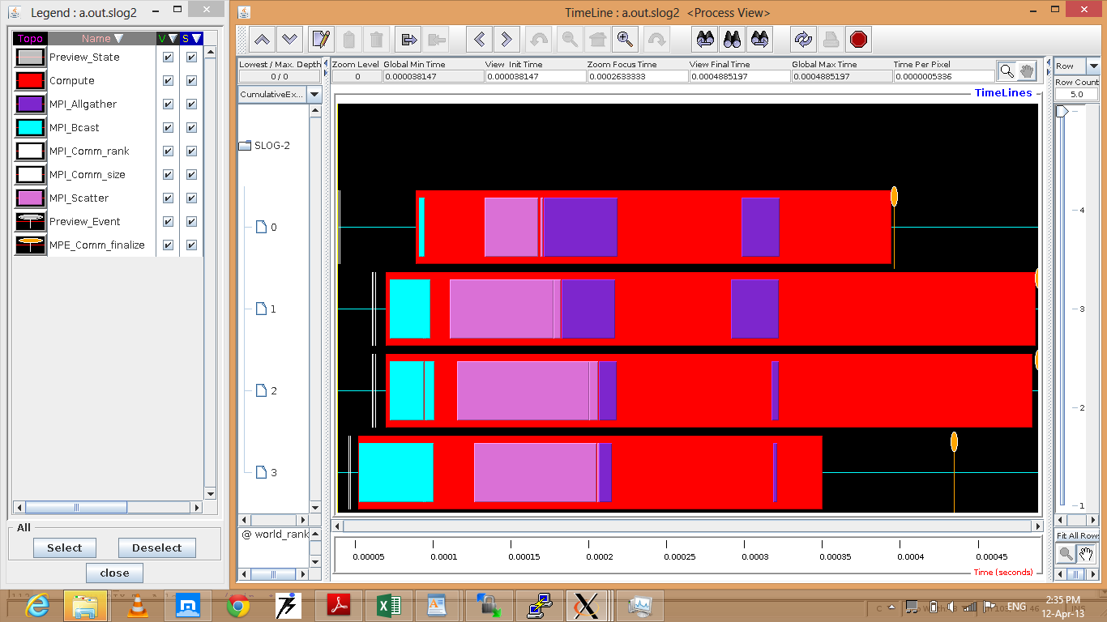
Parallel Jacobi

Slide 14
Parallel Jacobi

Slide 15
Parallel Jacobi

Slide 16
Thank You

